Slide 1
AGGREGATE FUNCTIONS

Slide 2
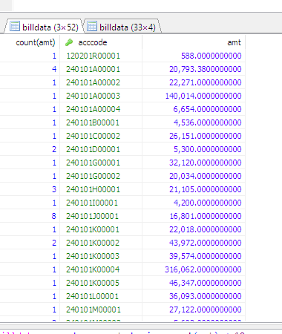
SQL HAVING Clause
The HAVING clause was added to SQL because the WHERE keyword could not be used with aggregate functions.
Syntax
SELECT COUNT(CustomerID), Country FROM Customers GROUP BY Country HAVING COUNT(CustomerID) > 5;
EX:select count(amt),acccode,amt from billdata group by acccode having count(amt) < 10;

Slide 3
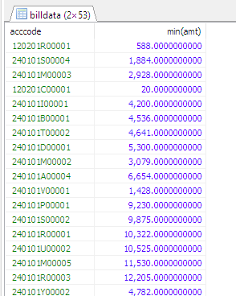
SQL GROUP BY Statement
To arrange identical data in groups
Used with select query
SELECT column_name(s) FROM table_name GROUP BY column_name(s) ORDER BY column_name(s);
EX:select acccode, min(amt) from billdata group by acccode order by amt asc;

Slide 4
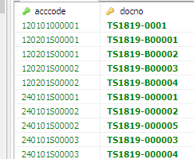
SQL EXISTS Operator
EXISTS operator returns true if the subquery returns one or more records.
SELECT column_name(s) FROM table_name WHERE EXISTS (SELECT column_name FROM table_name WHERE condition);
select acccode,docno from hdata WHERE exists ( select docno from idata where docno='TS1819-B00003');

Slide 5
SQL ANY and ALL Operators
The ANY and ALL operators are used with a WHERE or HAVING clause.
The ANY operator returns true if any of the subquery values meet the condition.
SELECT column_name(s) FROM table_name WHERE column_name operator ANY (SELECT column_name FROM table_name WHERE condition);
select name from itemgroup where code =any (select code from itemgroupmaster where catcode <'06')

Slide 6
SQL ALL
ALL operator returns TRUE if all of the subquery values meet the condition.
SELECT column_name(s) FROM table_name WHERE column_name operator ANY (SELECT column_name FROM table_name WHERE condition);
select name from itemgroup where code =all (select code from itemgroupmaster where catcode <'06')

Slide 7
SQL IN Operator
The IN operator is a shorthand for multiple OR conditions.
SELECT column_name(s) FROM table_name WHERE column_name IN (value1, value2, ...);
select name from itemgroup where code in ('01','02');

